Slide 1
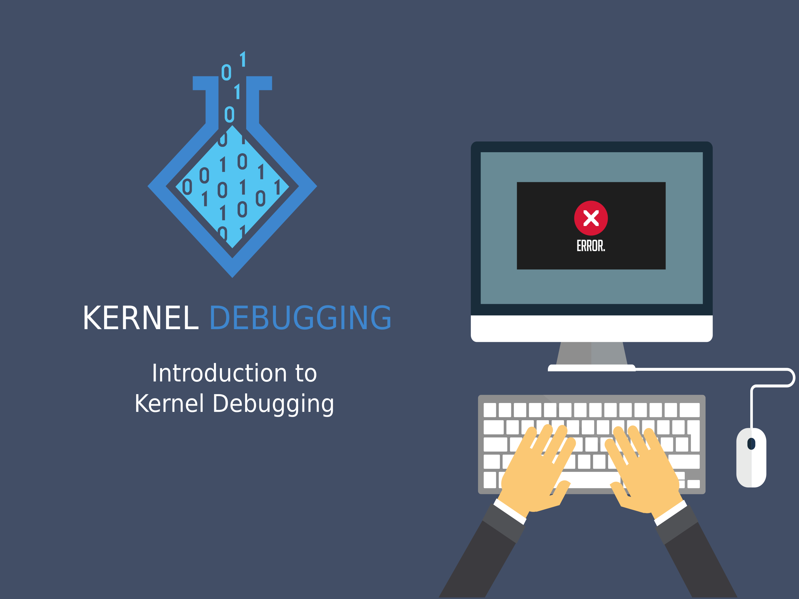

Slide 2


Slide 3


Outline
What is Kernel Debugging
Need of Kernel Debugging
Methods of Kernel Debugging
By Printing
By Querying
By Watching
Debuggin System faults
By Debuggers

Slide 4
What is Kernel Debugging?
Kernel
The kernel is a computer program that is the core of a computer's O/S, with complete control over entire system. As Kernel is the most important part or core part of an O/S it must need to be completely functioning for proper functioning of O/S.
Kernel Debugging
It is the technique of finding and removing the errors in the kernel code so as to avoid any panic condition in operating system like lockup, reboot, crashes, etc.

Slide 5

Why kernel debugging ?
Kernel code:
Not always executed in context of a process
Cannot be easily executed under a debugger
Cannot be traced easily; because it is a set of functionalities
not related to a specific process
Errors can also be exceedingly hard to reproduce and can bring down the
entire system with them, thus destroying much of the evidence that could
be used to track them down.
Bugs in kernel code being developed frequently result in a lockup or a reboot
It's difficult to locate the problem – entry points

Slide 6

How to debug Kernel:
Debugging By Printing
Debugginh By Querying
Debugging By Watching
Debugging system faults
Debugging using Debuggers

Slide 7
Debugging by Printing
The most common debugging technique is monitoring, which in done in programming applications by calling printf at suitable points. When you are debugging kernel code, you can accomplish the same goal with printk.
We cannot use printf since it uses c-library support so we use printk, for printing logs.
printk lets you classify messages according to their severity by associating
different loglevels.
There are eight possible log-level strings, defined in the header <linux/kernel.h>
We list them in order of decreasing severity:
KERN_EMERG
Used for emergency messages, usually those that precede a crash.
KERN_ALERT
A situation requiring immediate action.
KERN_CRIT
Critical conditions, often related to serious hardware or software failures.

Slide 8

Debugging by Printing .. (continue)
KERN_ERR
Used to report error conditions; device drivers often use KERN_ERR to report hardware difficulties. Used for debugging messages.
KERN_WARNING
Warnings about problematic situations that do not, in themselves, create serious problems with the system.
KERN_NOTICE
Situations that are normal, but still worthy of note. A number of security-related conditions are reported at this level.
KERN_INFO
Informational messages. Many drivers print information about the hardware they find at startup time at this level.
KERN_DEBUG
Used for debugging messages.
Example of usage of printk in kernel code
It is also possible to read and modify the console loglevel using the text file
/proc/sys/kernel/printk.

Slide 9
Debugging by Printing .. (continue)
Advantages of using printk:
It is very simple and easy to use, Different log levels make debuggin easy.
Message can be dump to various log levels.
Disadvantages of using printk:
A massive use of printk can slow down the system noticeably, even if you lower console_loglevel to avoid loading the console device, because syslogd keeps syncing its output files; thus, every line that is printed causes a disk operation. This is the right implementation from syslogd 's perspective. It tries to write everything to disk in case the system crashes right after printing the message; however, you don't want to slow down your system just for the sake of debugging messages.
But, if i don’t want to slow down my kernel
now what....??

Slide 10
Try Debugging by Querying

Slide 11
Debugging by Querying
More often than not, the best way to get relevant information is to query the system
when you need the information, instead of continually producing data. In fact, every
Unix system provides many tools for obtaining system information: ps, netstat, vmstat,
and so on.
A few techniques are available to driver developers for querying the system:
creating a file in the /proc filesystem
using the ioctl driver method
Using the /proc Filesystem
The /proc filesystem is a special, software-created filesystem that is used by the kernel
to export information to the world.
Each file under /proc is tied to a kernel function that generates the file's "contents" on
the fly when the file is read.
/proc is heavily used in the Linux system. Many utilities on a modern Linux distribution,
such as ps, top, and uptime, get their information from /proc
Implementing files in /proc, All modules that work with /proc should include <linux/proc_fs.h> to define the proper functions.

Slide 12
Debugging by Querying (continue ...)
Using the ioctl Method
ioctl, is a system call that acts on a file descriptor; it receives a number that identifies
a command to be performed and (optionally) another argument, usually a pointer.
As an alternative to using the /proc filesystem, you can implement a few ioctl
commands tailored for debugging.
These commands can copy relevant data structures from the driver to user space where you can examine them.
more difficult than using /proc, because you need another program to issue the ioctl and display the results. This program must be written, compiled, and kept in sync with the module you're testing.
Then Why ..??
Because, There are times when ioctl is the best way to get information, because it runs faster than reading /proc.
It retrives the data in binary from, retrieving the data in binary form is more efficient than reading a text file.

Slide 13
Debugging by Watching
My favorite

Slide 14
Debugging by Watching
Sometimes minor problems can be tracked down by watching the behavior of an
application in user space
There are various ways to watch a user-space program working.
You can run a debugger on it to step through its functions.
Add print statements.
Run the program under strace.
Using strace command
The strace command is a powerful tool that shows all the system calls issued by a user-space program.
Not only does it show the calls, but it can also show the arguments to the calls andtheir return values in symbolic form. When a system call fails, both the symbolic value of the error (e.g., ENOMEM) and the corresponding string (Out of memory) are displayed.
strace prints tracing information on stderr.
strace receives information from the kernel itself. This means that a program can betraced regardless of whether or not it was compiled with debugging support.

Slide 15
Debugging System Faults

Slide 16
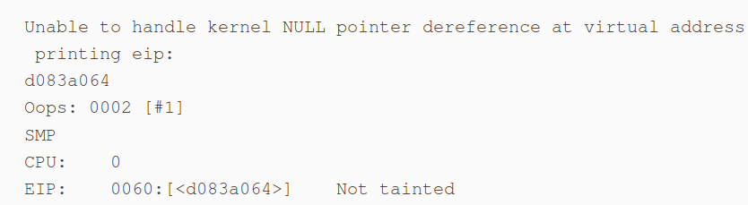
Debugging System Faults
Even if you've used all the monitoring and debugging techniques, sometimes bugs
remain in the driver, and the system faults when the driver is executed. When this
happens, it's important to be able to collect as much information as possible to solve
the problem.
Oops Messages
Most bugs show themselves in NULL pointer dereferences or by the use of other
incorrect pointer values. The usual outcome of such bugs is an oops message.
An oops displays the processor status at the time of the fault, including the contents
of the CPU registers and other seemingly incomprehensible information.
Example of how oops message occurs,

Slide 17
Using Debuggers
Sound obivious

Slide 18
Using debuggers
The last resort in debugging modules is using a debugger to step through the code, watching the value of variables and machine registers. This approach is time-consuming and should be avoided whenever possible.
Using gdb
The debugger must be invoked as though the kernel were an application. In addition
to specifying the filename for the ELF kernel image, you need to provide the name of
a core file on the command line.
A typical invocation of gdb looks like the following:
From within gdb, you can look at kernel variables by issuing the standard gdb commands. For example: p jiffies prints no. of clock ticks from system boot to current time.

Slide 19
Using debuggers Contd…
Numerous capabilities normally provided by gdb are not available when you are working with the kernel.
For example, gdb is not able to modify kernel data;
It expects to be running a program to be debugged under its own control before playing with its memory image.
It is also not possible to set breakpoints or watchpoints, or to single-step through kernel functions.
So we introduce,
Using kdb (Linus Style)
According to Linus, interactive debuggers lead to poor fixes, those which patch up symptoms rather than addressing the real cause of problems.
Once you are running a kdb-enabled kernel, there are a couple of ways to enter the debugger. Pressing the Pause (or Break) key on the console starts up the debugger. kdb also starts up when a kernel oops happens or when a breakpoint is hit.
Note that just about everything the kernel does stops when kdb is running.

Slide 20
References
Linux Device Drivers, 3rd Edition by Greg Kroah-Hartman,
Alessandro Rubini, Jonathan Corbet
https://www.safaribooksonline.com/library/view/linux-device-drivers/0596005903/ch04.html

Slide 21


Slide 22


